Slide 2
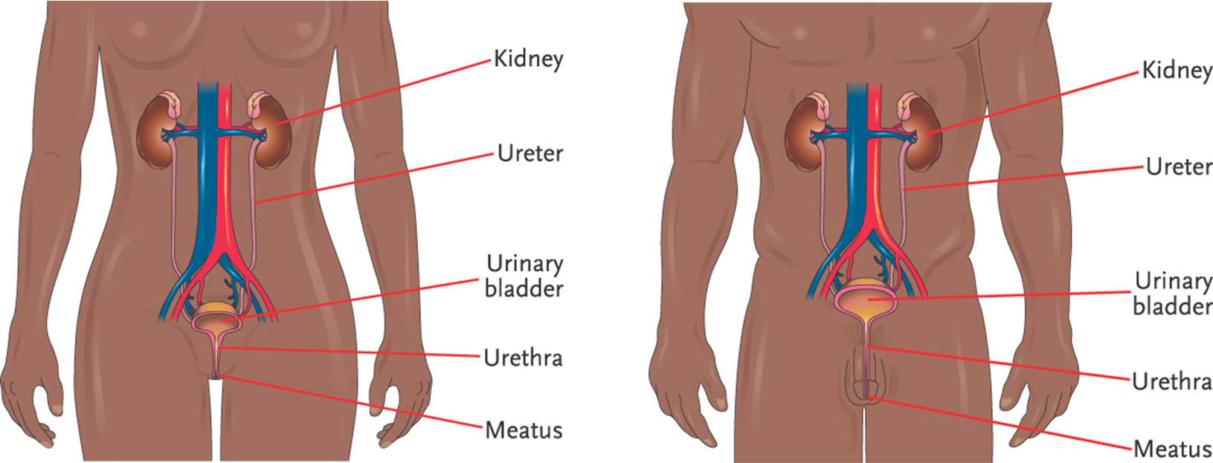
Chapter 15, LO1, content 1
Key Material 15-1: The Urinary System (Male and Female)

Slide 3
LO1, content 2
Describe the structure and function of the urinary system
Remember these points about the urinary system:
Composed of two kidneys, two ureters, one urinary bladder, and a single urethra
Has two important functions: eliminates waste products created by the cells and maintains the water balance in the body

Slide 4
LO1, content 3
Describe the structure and function of the urinary system
Normal changes of aging include the following:
Decreased ability of kidneys to filter blood
Weakened bladder muscle tone
Bladder holds less urine, causing more frequent urination
The bladder may not empty completely, causing a greater risk of infection

Slide 5
LO2, key term
Discuss common medications used to treat urinary incontinence
Define the following term:
urinary incontinence
the inability to control the bladder, which leads to an involuntary loss of urine.

Slide 6
LO2, content 1
Discuss common medications used to treat urinary incontinence
REMEMBER:
Urinary incontinence is not a normal change of aging

Slide 7
LO2, content 2
Discuss common medications used to treat urinary incontinence
Understand the following about treatment for urinary incontinence:
Before ordering medications, doctor may review/make adjustments to resident’s fluid intake
In female residents, exercises to strengthen the pelvic floor can help prevent incontinence
The antidepressant duloxetine (Cymbalta) works by an unknown mechanism to relieve incontinence
Urinary antispasmodic agents reduce bladder spasms that can cause incontinence
Estrogen may be administered vaginally to female residents to treat incontinence
Table on textbook p. 145 (or handout) details other specific drugs

Slide 8
LO2, content 3
Discuss common medications used to treat urinary incontinence
Care guidelines for urinary incontinence include the following:
Observe for change in mood or mental status in residents taking duloxetine. This medication can cause agitation, nervousness, fatigue, dizziness, and insomnia
Report any episodes of incontinence you observe. It is a major risk factor for pressure injuries
Report dark or foul-smelling urine. These can be signs of a urinary tract infection
Never refer to incontinence pads or briefs as diapers

Slide 9
LO3, key terms
Discuss common medications used to treat urinary retention and urinary obstruction
Define the following terms:
urinary retention
a condition in which the bladder is not fully emptied during urination.
urinary obstruction
a partial or complete blockage of urine.

Slide 10
LO3, content 1
Discuss common medications used to treat urinary retention and urinary obstruction
Understand the following about treatment for urinary retention and urinary obstruction:
Drugs include
Alpha-blocking agents (longer list of specific drugs for use in males than in females)
Can cause orthostatic hypotension and dizziness
Cholinergic agents
Can cause nausea, diarrhea, abdominal cramps
Treatment for urinary obstruction can also include removing the cause of the obstruction (e.g., kidney stones)
Analgesics may be ordered to ease the pain of passing kidney stones
Table on textbook p. 145 (or handout) details specific drugs

Slide 11
LO3, content 2
Discuss common medications used to treat urinary retention and urinary obstruction
Care guidelines for urinary retention and urinary obstruction include the following:
Observe residents taking alpha-blocking agents for orthostatic hypotension and dizziness. These effects can create a fall risk
Be familiar with the possible side effects of cholinergic agents. Share resident reports of excess salivation, nausea, diarrhea, and abdominal cramps with the nurse. This can help determine the best dosage for the resident

Slide 12
LO4, key terms
Discuss common medications used to treat urinary tract infection (UTI)
Define the following term:
urinary tract infection (UTI)
a bacterial infec­tion of the urethra, bladder, ureter, or kidney that results in painful burning during urination and the frequent feeling of needing to urinate.

Slide 13
LO4, content 1
Discuss common medications used to treat urinary tract infection (UTI)
Be familiar with these risk factors for UTI:
Female residents are at greater risk than male residents for UTI due to a shorter urethra and the location of the urethra in relation to the vagina and anus (possible sources of bacteria)
Catheter use is associated with UTI
Urinary incontinence also causes elevated risk

Slide 14
LO4, content 2
Discuss common medications used to treat urinary tract infection (UTI)
Treatment for urinary tract infection (UTI) includes the following:
Antibiotics; specific agent depends on location/severity
Uncomplicated cystitis (bladder infection) and uncomplicated pyelonephritis (kidney infection) usually treated with oral antibiotics
Residents with signs of sepsis or with abnormalities in the urinary tract may be treated with intravenous antibiotics
Analgesics may be used to control pain (phenazopyridine) but will not cure UTI
Table on textbook pp. 145–146 (or handout) details other specific drugs

Slide 15
LO4, content 3
Discuss common medications used to treat urinary tract infection (UTI)
Care guidelines for urinary tract infection include the following:
Understand that some residents with UTI may have no symptoms. This can allow a UTI to get worse before it is diagnosed
Report changing/worsening symptoms to a nurse (fever, chills, nausea/vomiting, pain in the side of the body, dark urine, strong urine odor)
Observe and report confusion. This is a common UTI symptom in elderly people
Observe for signs and symptoms of anaphylaxis in residents taking antibiotics
Encourage fluid intake

Slide 16
LO5, key terms
Discuss common medications used to treat renal failure and fluid imbalance
Define the following terms:
chronic renal failure
a condition that oc­curs when the kidneys cannot eliminate certain waste products from the body; also called chronic kidney failure.
dialysis
an artificial means of removing the body’s waste products when the kidneys are no longer able to function properly.
fluid balance
taking in and eliminating equal amounts of fluid.

Slide 17
LO5, content 1
Discuss common medications used to treat renal failure and fluid imbalance
Treatment for chronic renal failure includes the following:
Dialysis
Fluid restrictions
Medications to control high blood pressure (commonly associated with CRF)
ACE inhibitors (generic names ending in -pril
Angiotensin receptor blockers ARBs; generic names ending in -sartan
Statins to reduce lipids (fats) in the bloodstream
Table on textbook p. 146 (or handout) details specific drugs

Slide 18
LO5, content 2
Discuss common medications used to treat renal failure and fluid imbalance
Understand the following about treatment for fluid imbalance:
Diuretics may be ordered for residents (e.g., residents with CRF) who experience edema
Residents who are severely dehydrated (e.g., due to uncontrolled vomiting or diarrhea) may receive intravenous fluids; mild dehydration may be treated with oral rehydration solutions
REMEMBER:
Follow instructions on the MAR for weighing residents. Residents who take diuretics may be weighed regularly to monitor fluid balance

Slide 19
LO5, content 3
Discuss common medications used to treat renal failure and fluid imbalance
Care guidelines for chronic renal failure include the following:
Remember that CRF is not just a disease. It can affect the entire body. Know residents’ mental and physical baseline (their personal “normal”) and report changes to the nurse
Administer additional medications as ordered. Certain vitamins, iron, and stool softeners may be ordered in some cases
Follow any fluid restrictions in place

